Slide 1
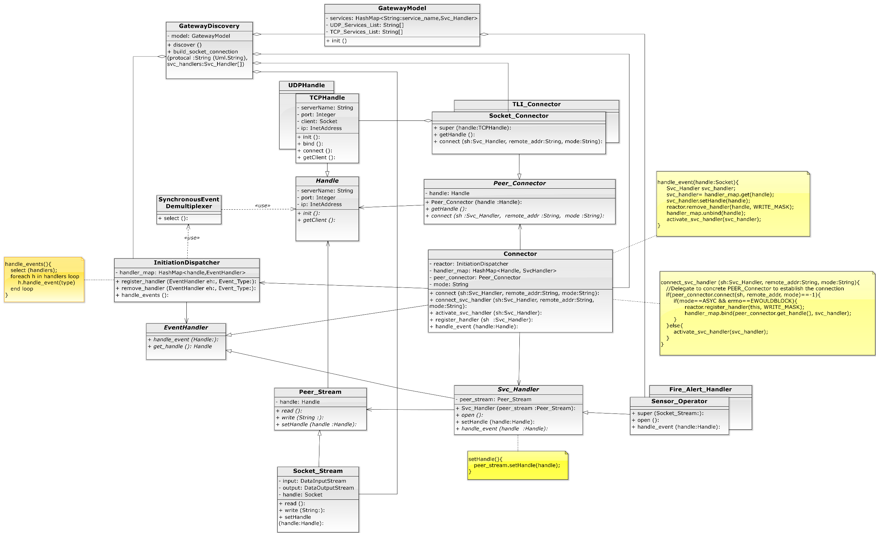
1
Discover Gateways
2
Establish connections
Connector
Reactor
4
3
Monitor all registered handle, if any handle is active, call back to corresponding Event Handler.
If the connection is established completely
, activate service handler. Else, register the connector to Reactor and wait for call back.

